Slide 1
Javascript Essentials
Understanding the Basic Terms and Syntax of Javascript

Slide 2
About Javascript
Javascript is a high-level, dynamic, untyped, and interpreted programming language. It has been standardized in the ECMAScript language specification.
Some common frameworks in javascript include
Jquery
Angular
React JS
Ember JS
NodeJS

Slide 3
Course Outline
Basic Syntax
Data types
Primitive Data Type(Int, String, Boolean)
(Array, Object)
DOM Operation(Document Object Model)
document.getElementById
document.getElementsByTagName
document.getElementsByClassName
Control structure
Conditional statements(if/else/elseif/switch)
Iterations/loop
Countered control loop(for loop)
Sentinel control loop(while/do)
Modularization(Functions)
Unconditional Statement(break/continue)

Slide 4
Basic Javascript Syntax

Slide 5
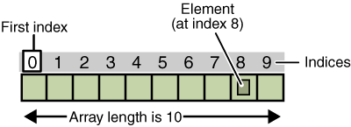
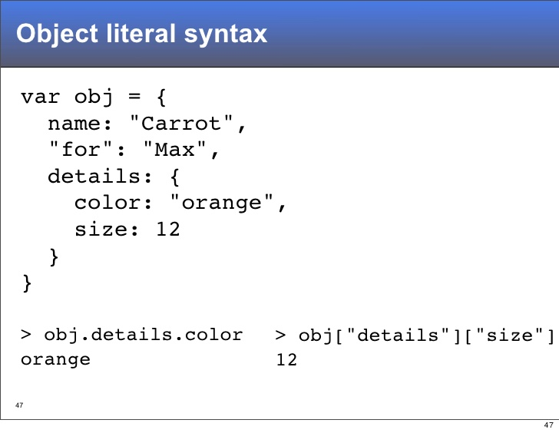
Data Types
Primitive Data Types
Arrays
Object

Slide 6

DOM Manipulation
getElementById
getElementsByTagName
getElementsByClassName

Slide 7
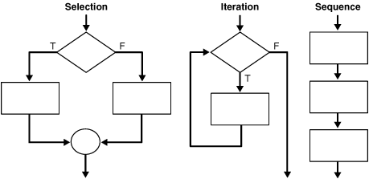
Control Structures
Conditional statements
If
Else
Else if
Switch
Iterations/loop
Countered control loop(for loop)
Sentinel control loop(while/do)
Modularization(Functions)
Unconditional Statement
Break
continue

Slide 8
</coding>

Slide 9
Assignment
Instruction:
Merge all we have done to get some thing like this

Slide 10

Thank You
See You Next Week

